Slide 1

CAPSTONE PROJECT (SHOPFORHOME)
PRESENTED BY:
Bhargavi Kunta
Manas Hassija
Kaza Geetanjali
Sake Bhavana
M Annie Merlin
JAVA &AWS C4 GROUP-3
MENTOR:MR.NEERAJ KUMAR KHERA

Slide 2
INTRODUCTION
Problem Statement: ShopForHome is a popular Store in the market for shopping the home décor stuff . Due to Covid 19 all the offline shopping stopped. So, the store wants to move to the cloud platforms and wants their own web application.
There are 2 users on the application: -
1. User
2. Admin

Slide 3
TECHNOLOGIES USED:
Angular
Spring Boot
SQL
AWS
Softwares Used:
Eclipse IDE
Visual Studio code
MySQL
AWS

Slide 4
Sprint I Objectives
1.Create git repository
2.Create database schema (all tables along with their relationships)
3.Create entities in Spring
4.Create Microservice based structure
5.CRUD on User and Products
6.Create an eCommerce Template in Angular (Static only) to hold images and products lists
7.Develop Search Functionality in Angular
8.Bulk upload implementation

Slide 5
Sprint II Objectives
1.Cart option
2.Stock and Sales reports
3.Create Data Transfer objects
4.Create repository
5Create Service layer logic
6.Create Controller to direct rest api
7.Create Discount Microservice

Slide 6
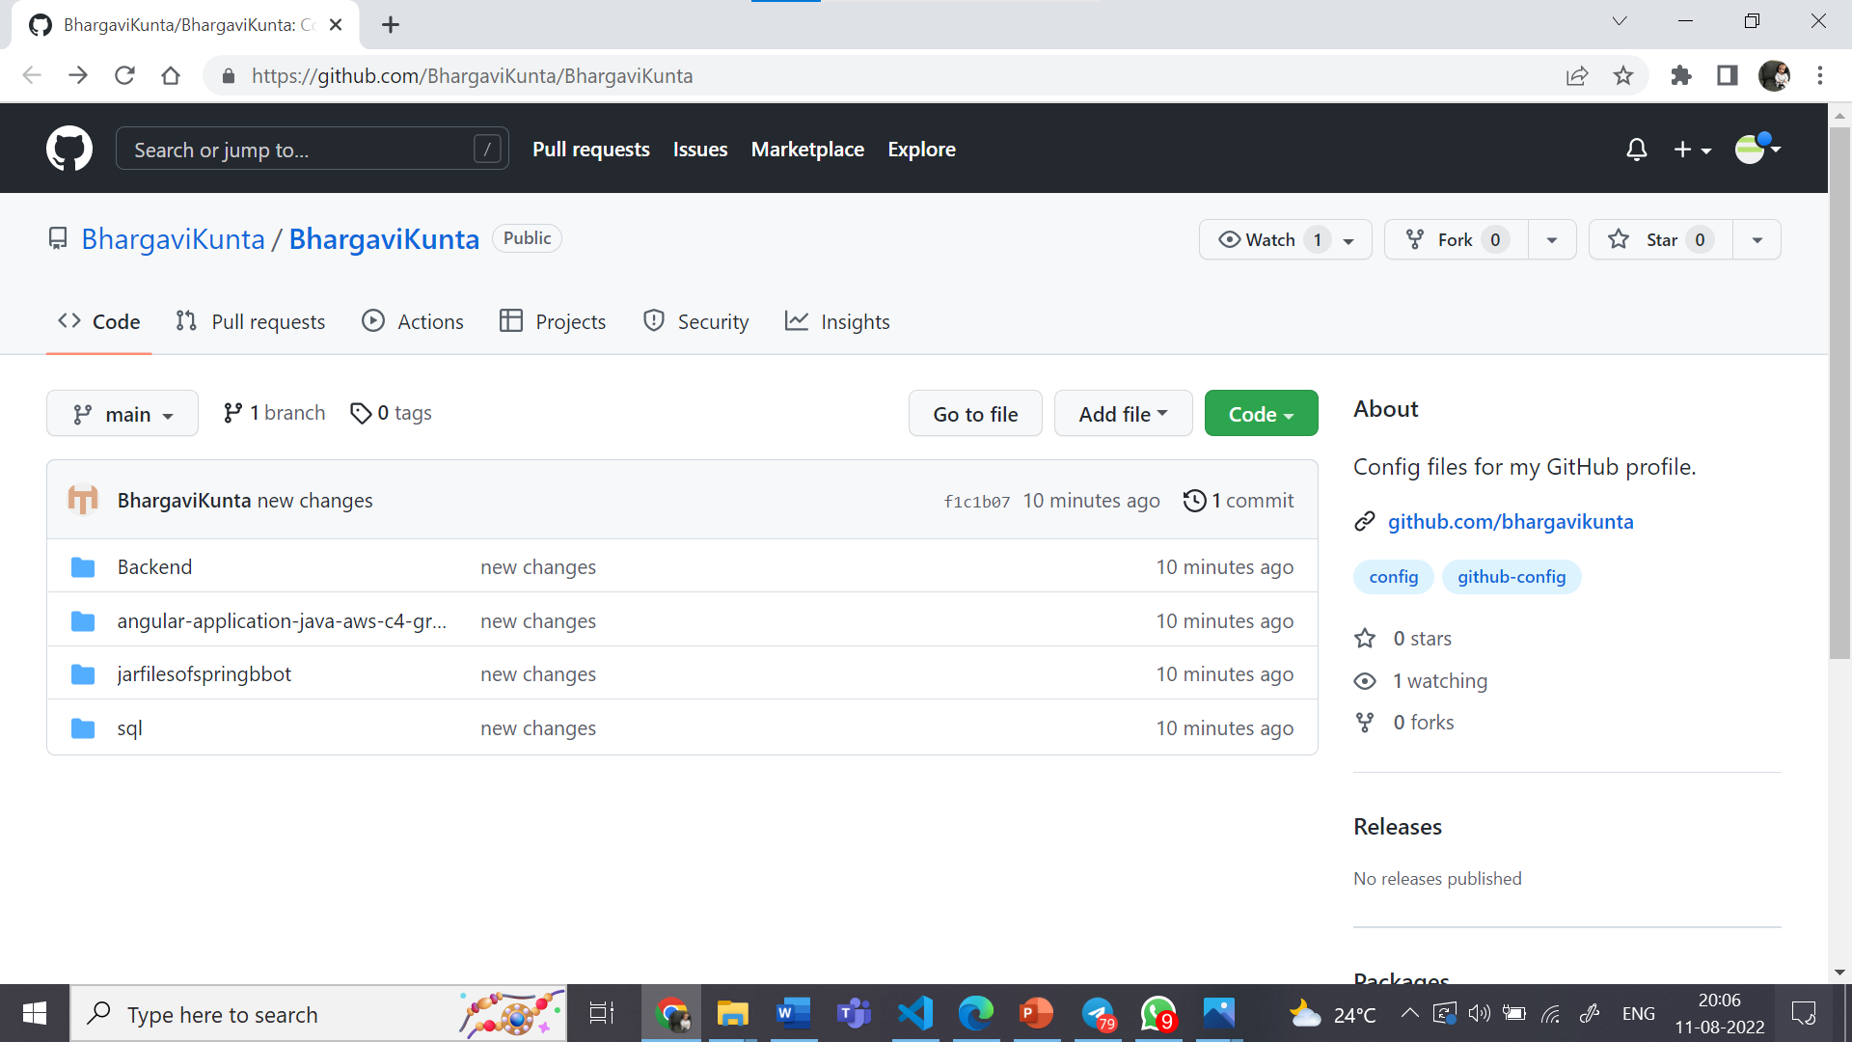
GIT REPOSITORY

Slide 7
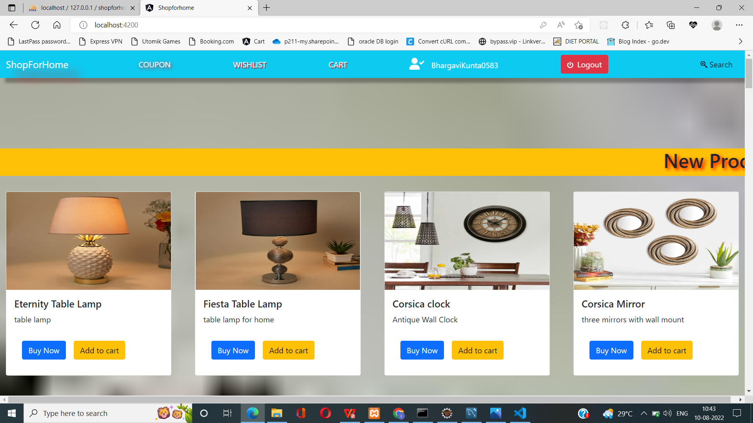
ECOMMERCE TEMPLATE(HOME PAGE)

Slide 8
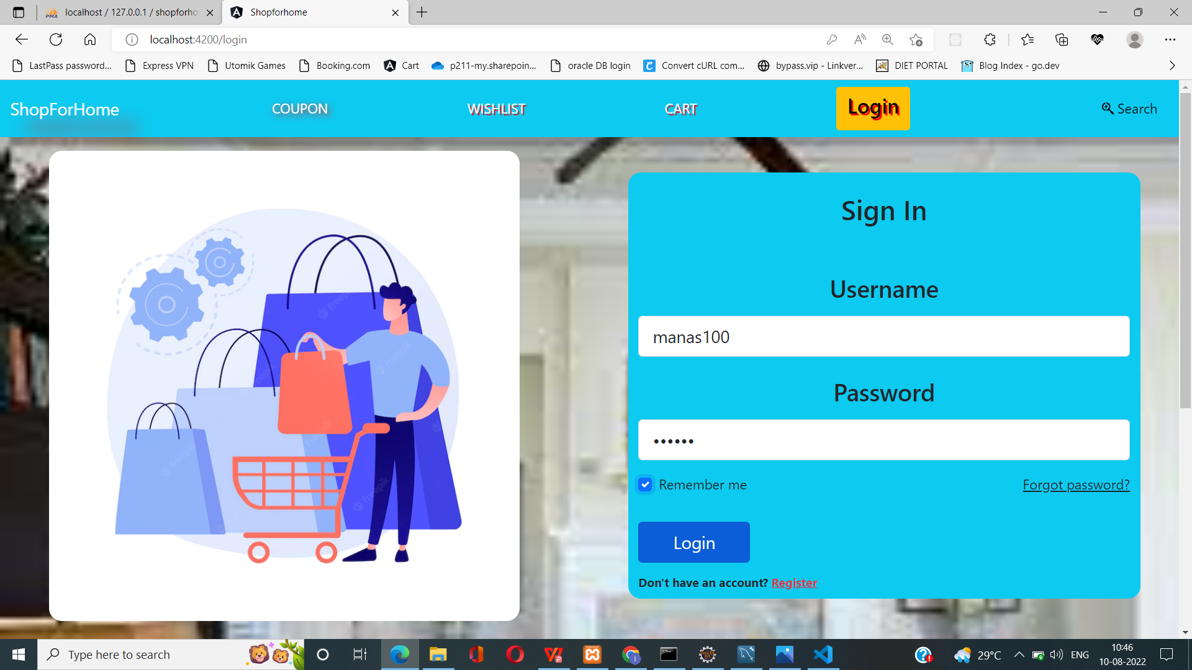
SIGN IN (For User and Admin)

Slide 9
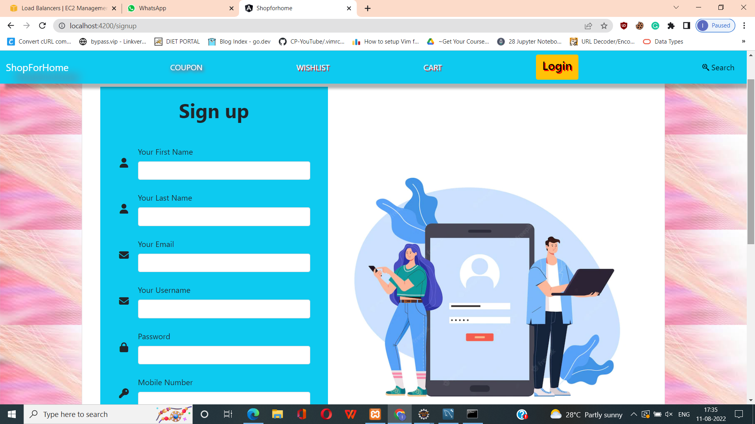
SIGN UP

Slide 10
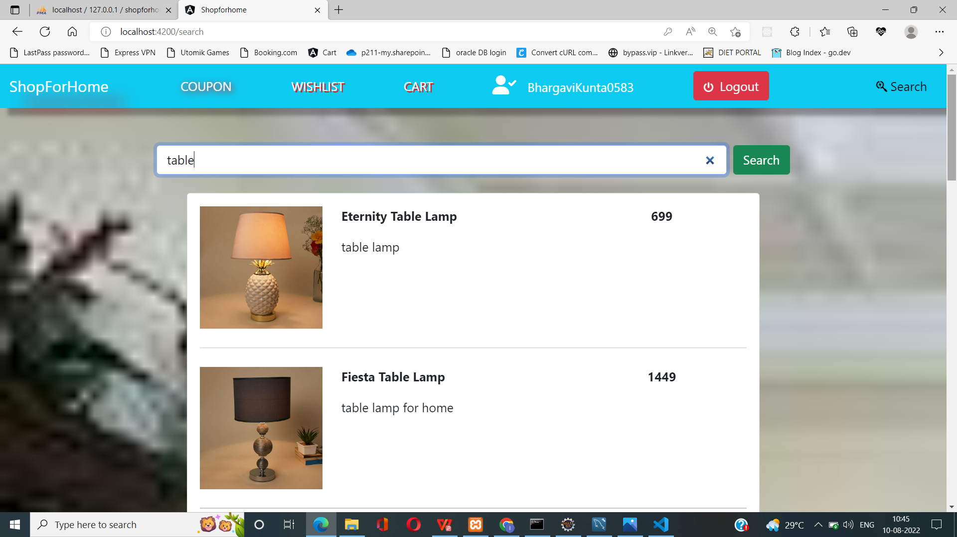
SEARCH

Slide 11
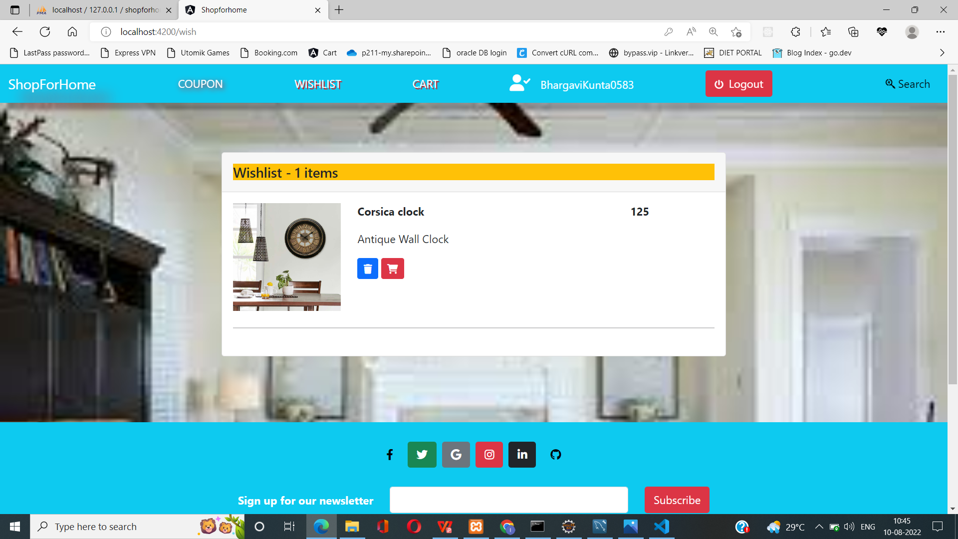
WISHLIST

Slide 12
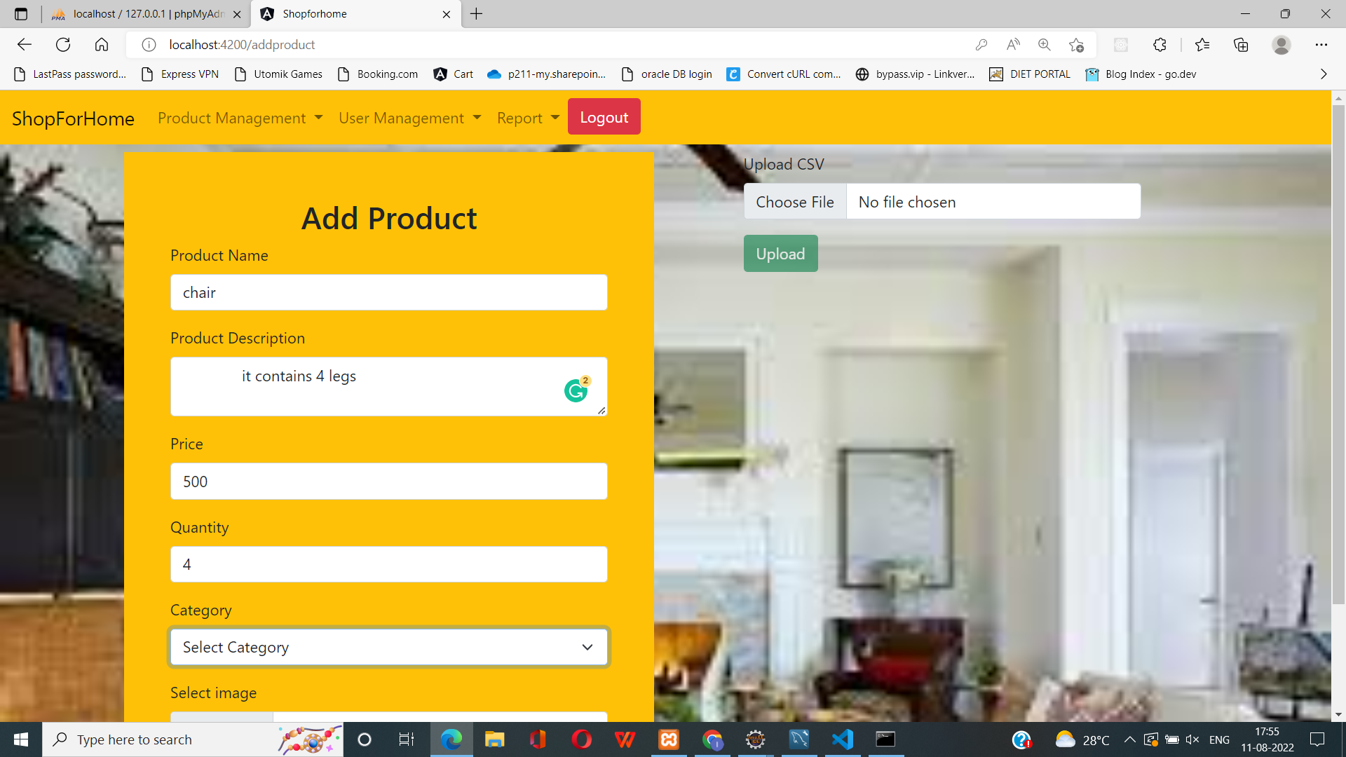
BULK UPLOAD

Slide 13
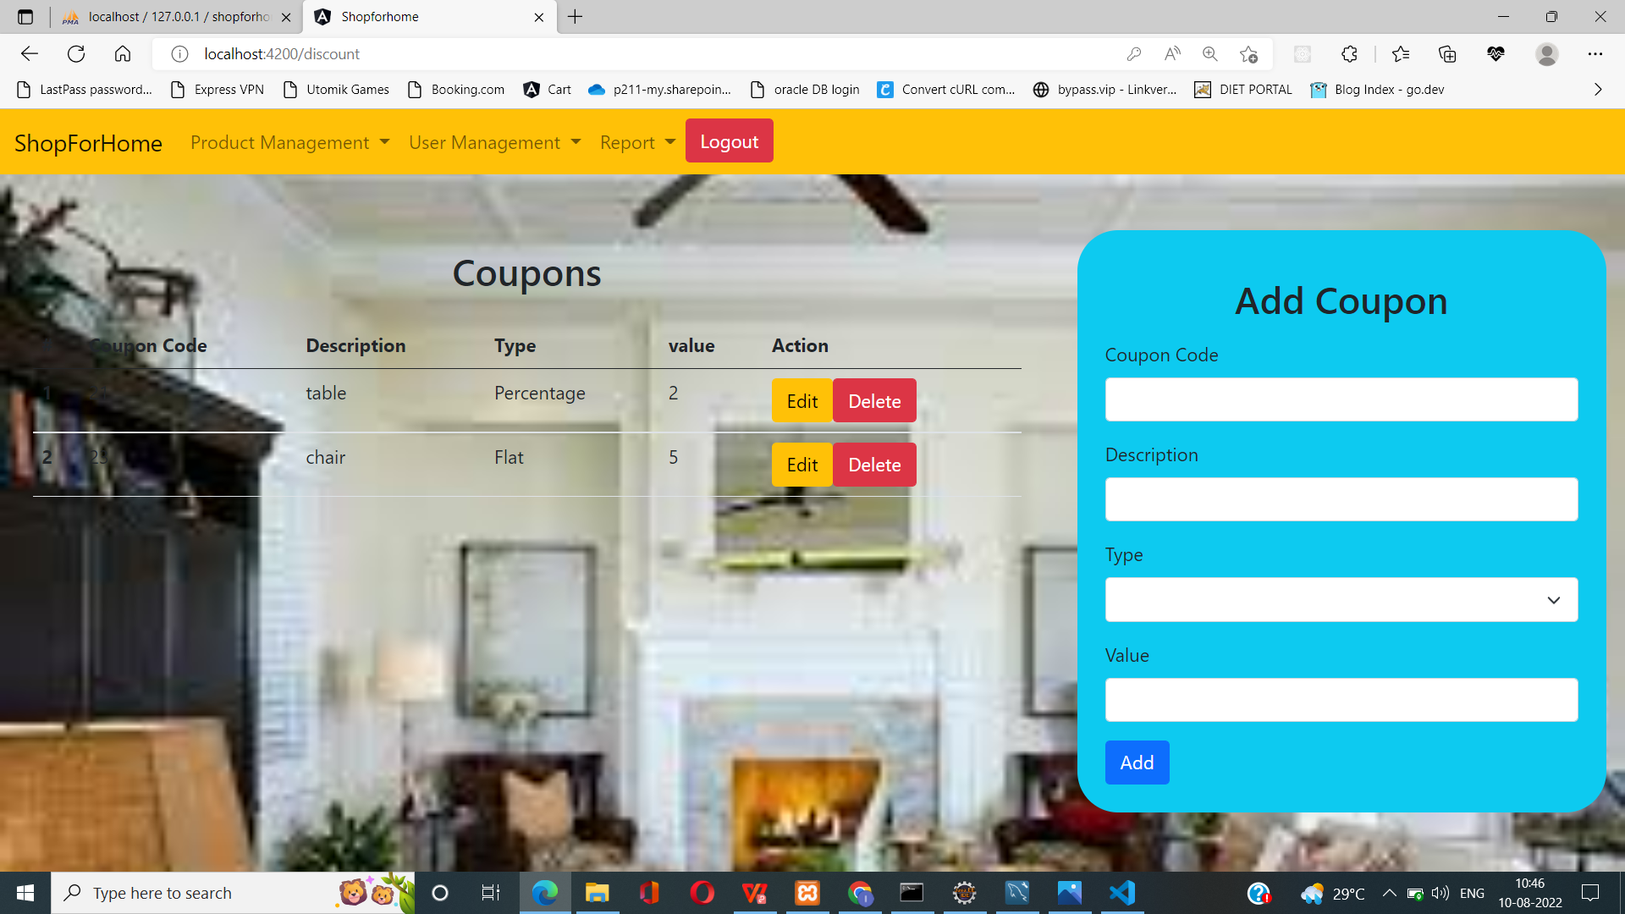
COUPONS (CRUD by Admin)

Slide 14
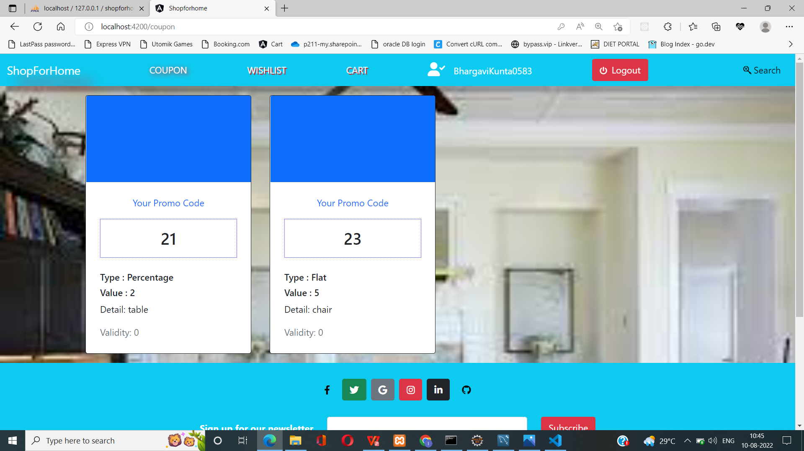
DISCOUNT COUPONS

Slide 15
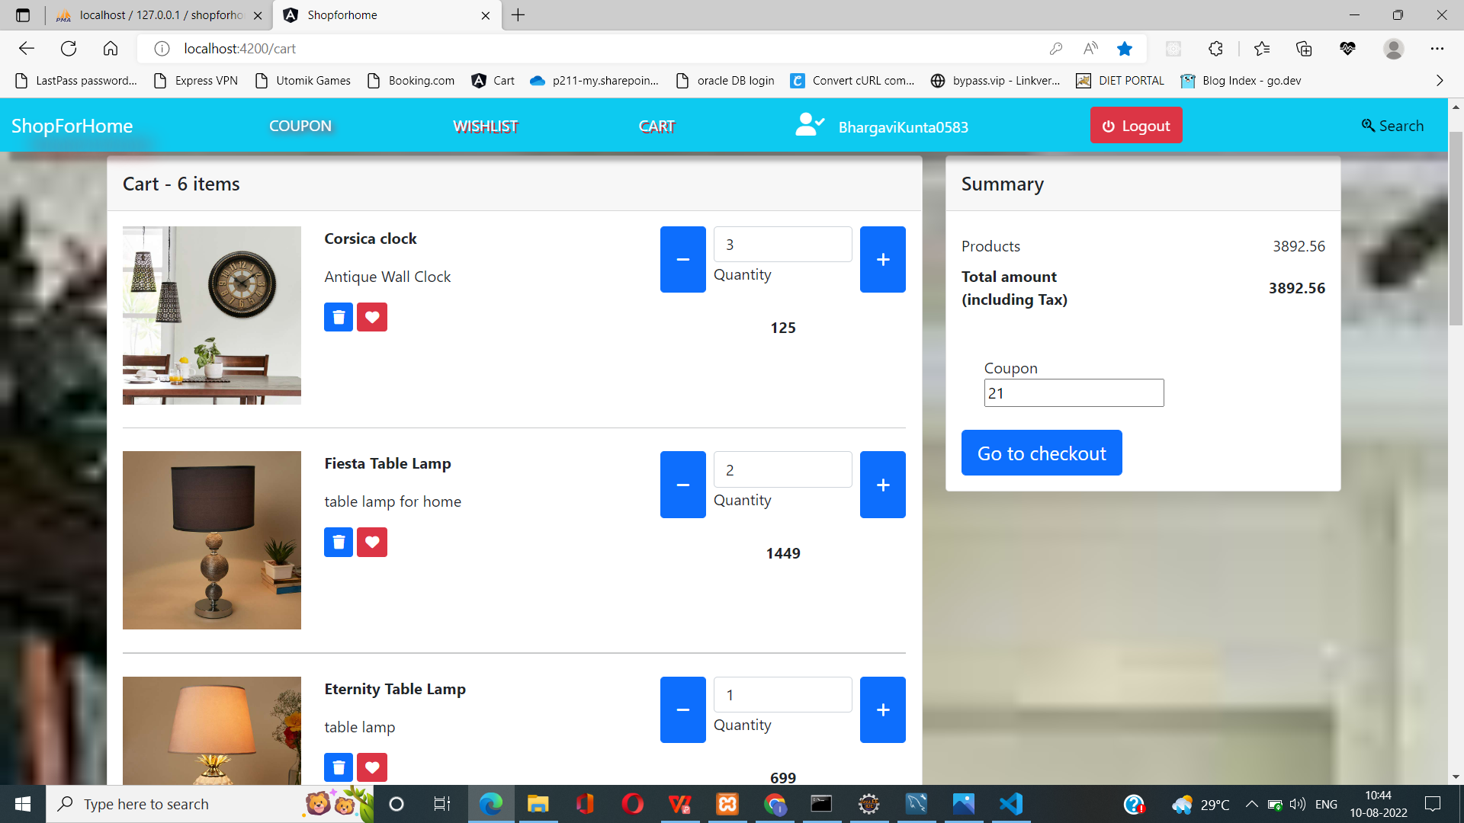
COUPONS (Can be applied at checkout)

Slide 16
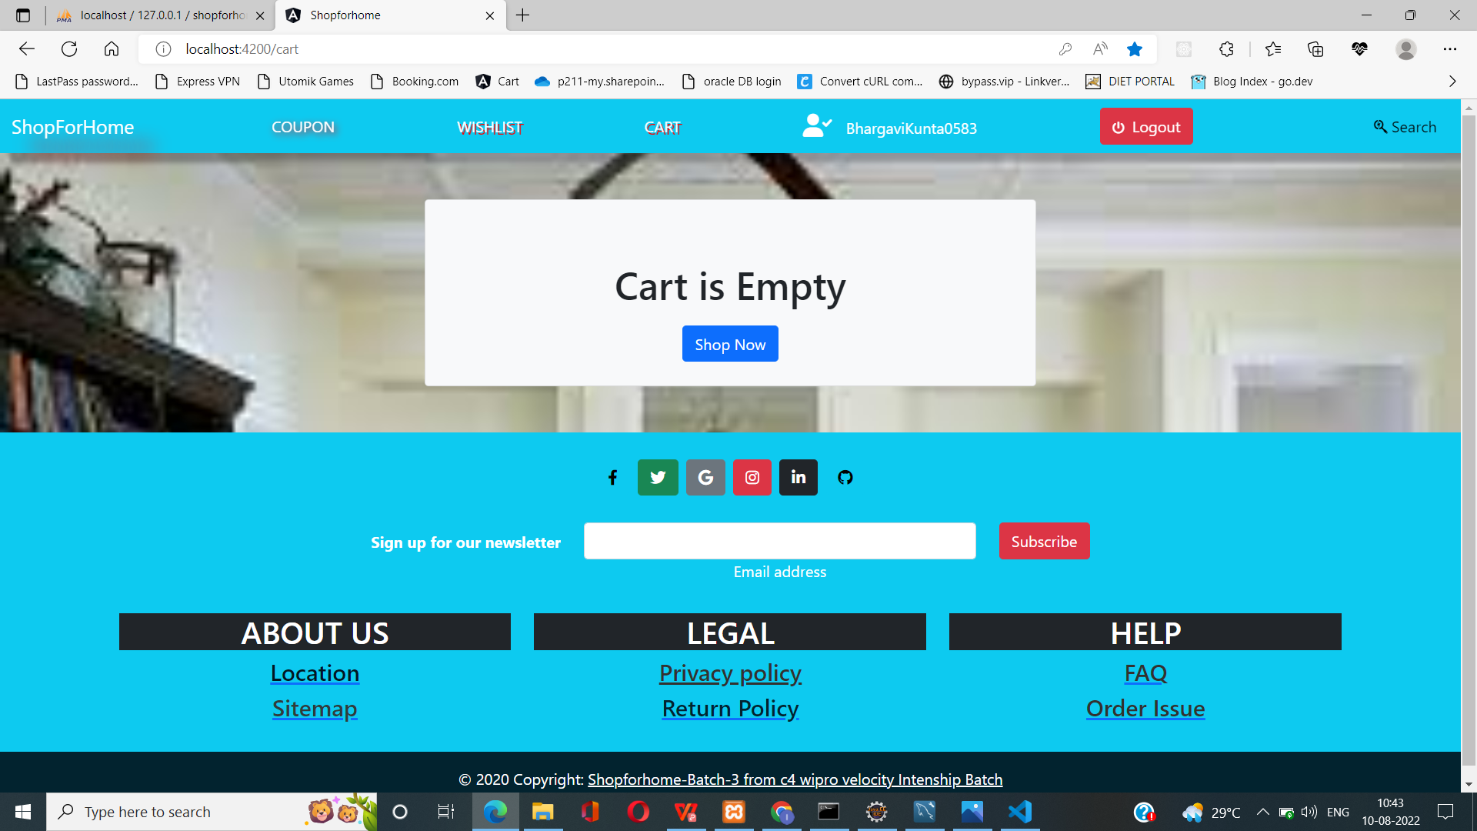
CART OPTION (Empty Cart)

Slide 17

CART OPTION

Slide 18
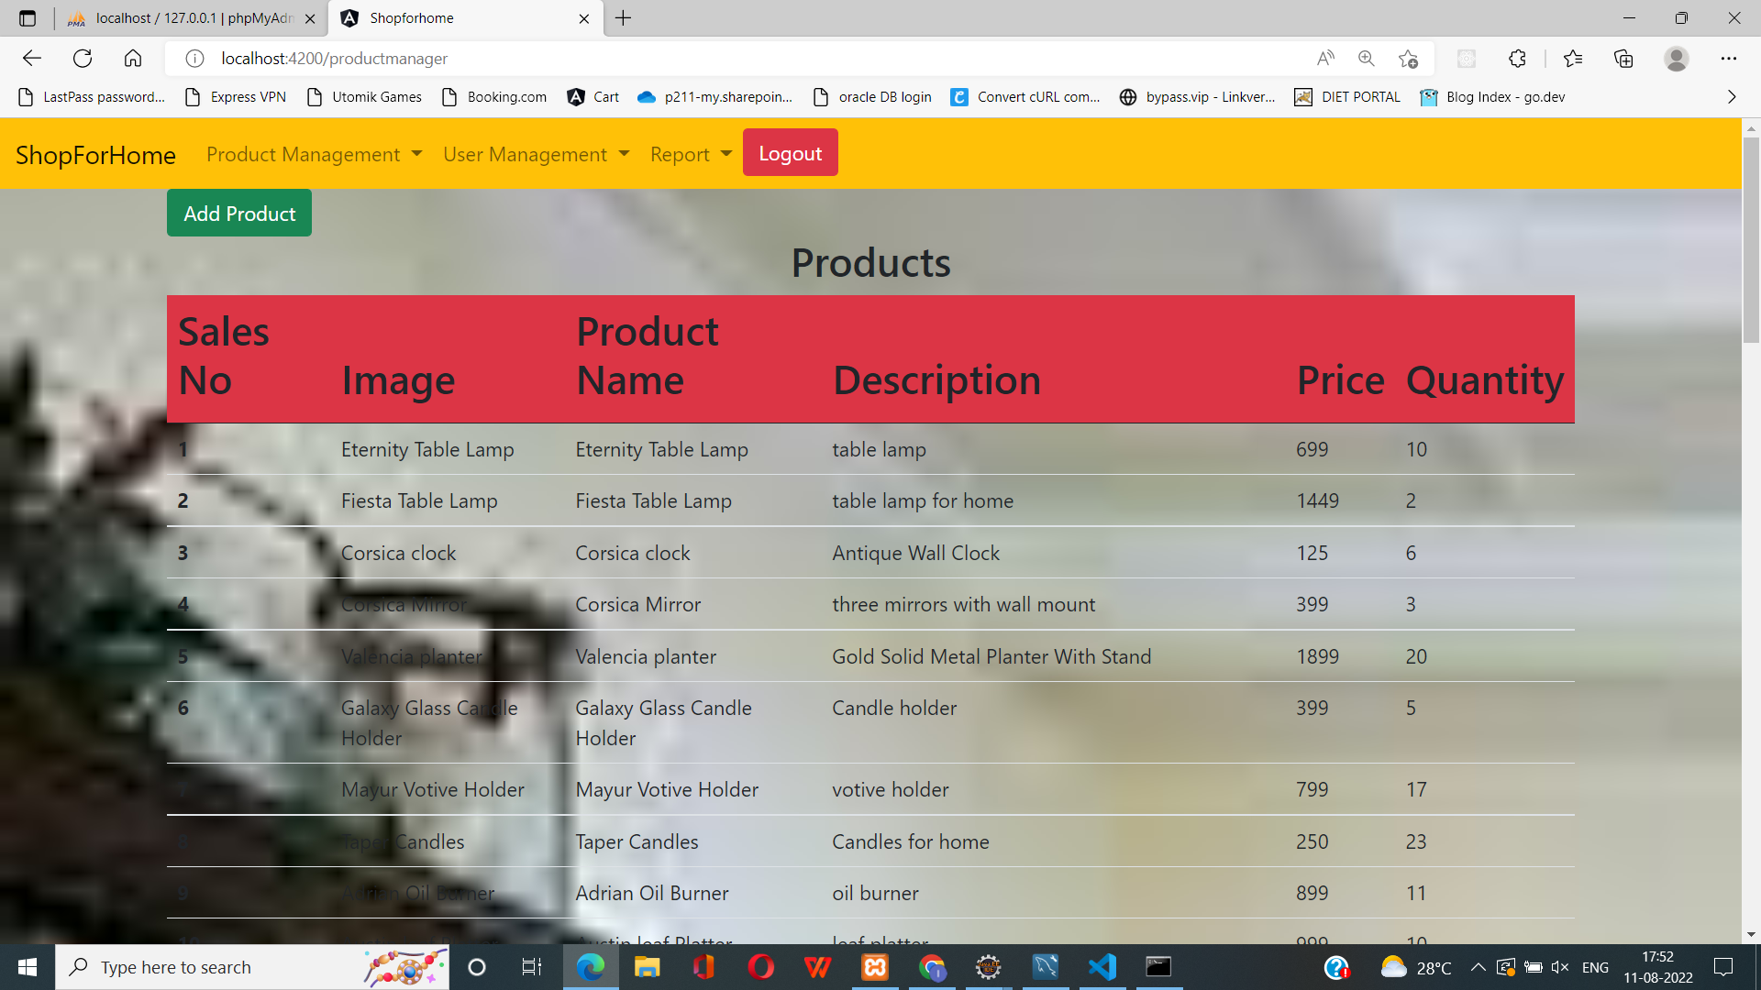
STOCK REPORT (Admin)

Slide 19
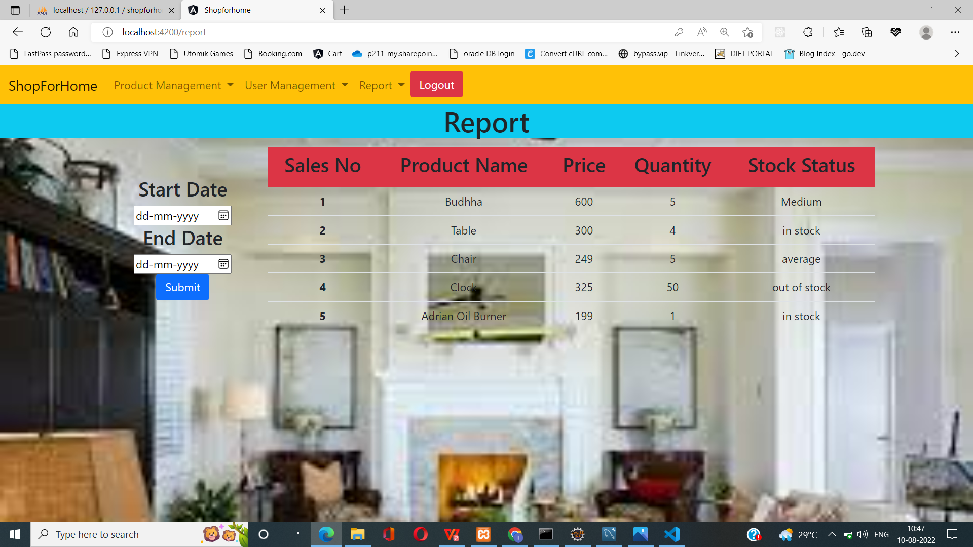
SALES REPORT (Admin)

Slide 20
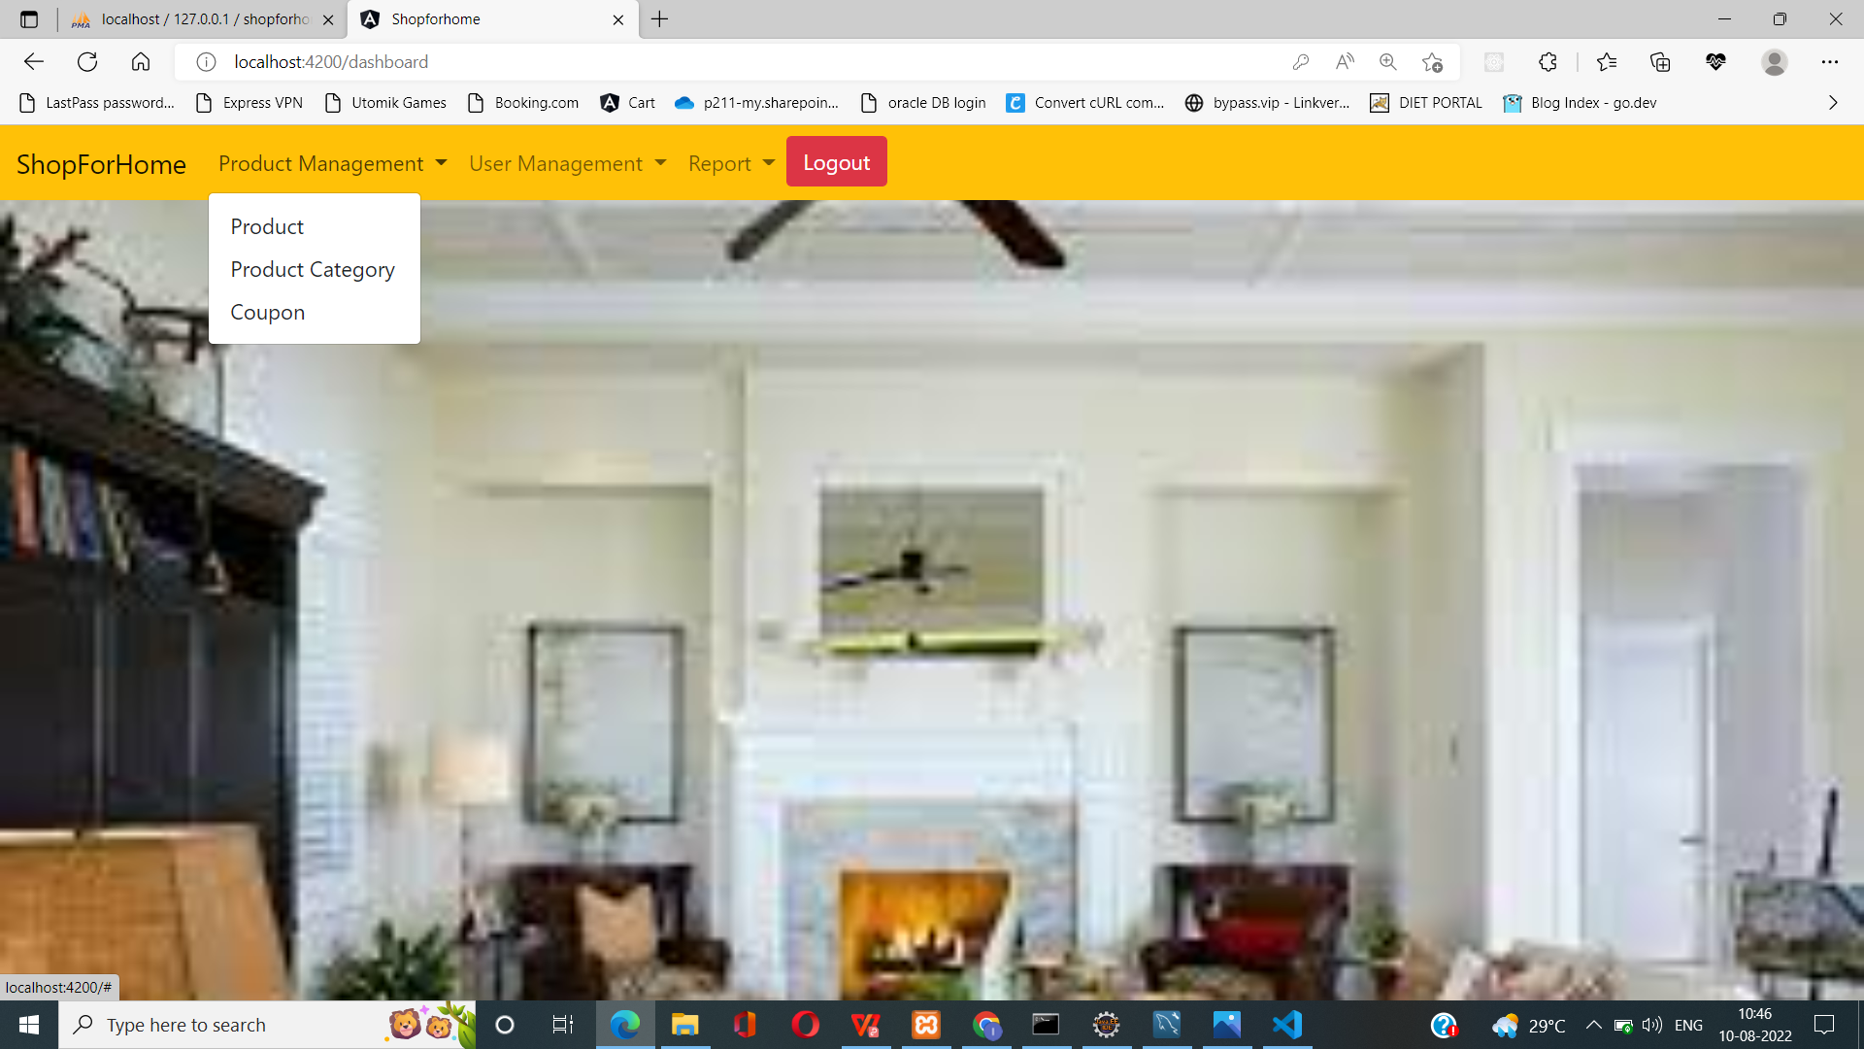
PRODUCT MANAGEMENT (Admin)

Slide 21
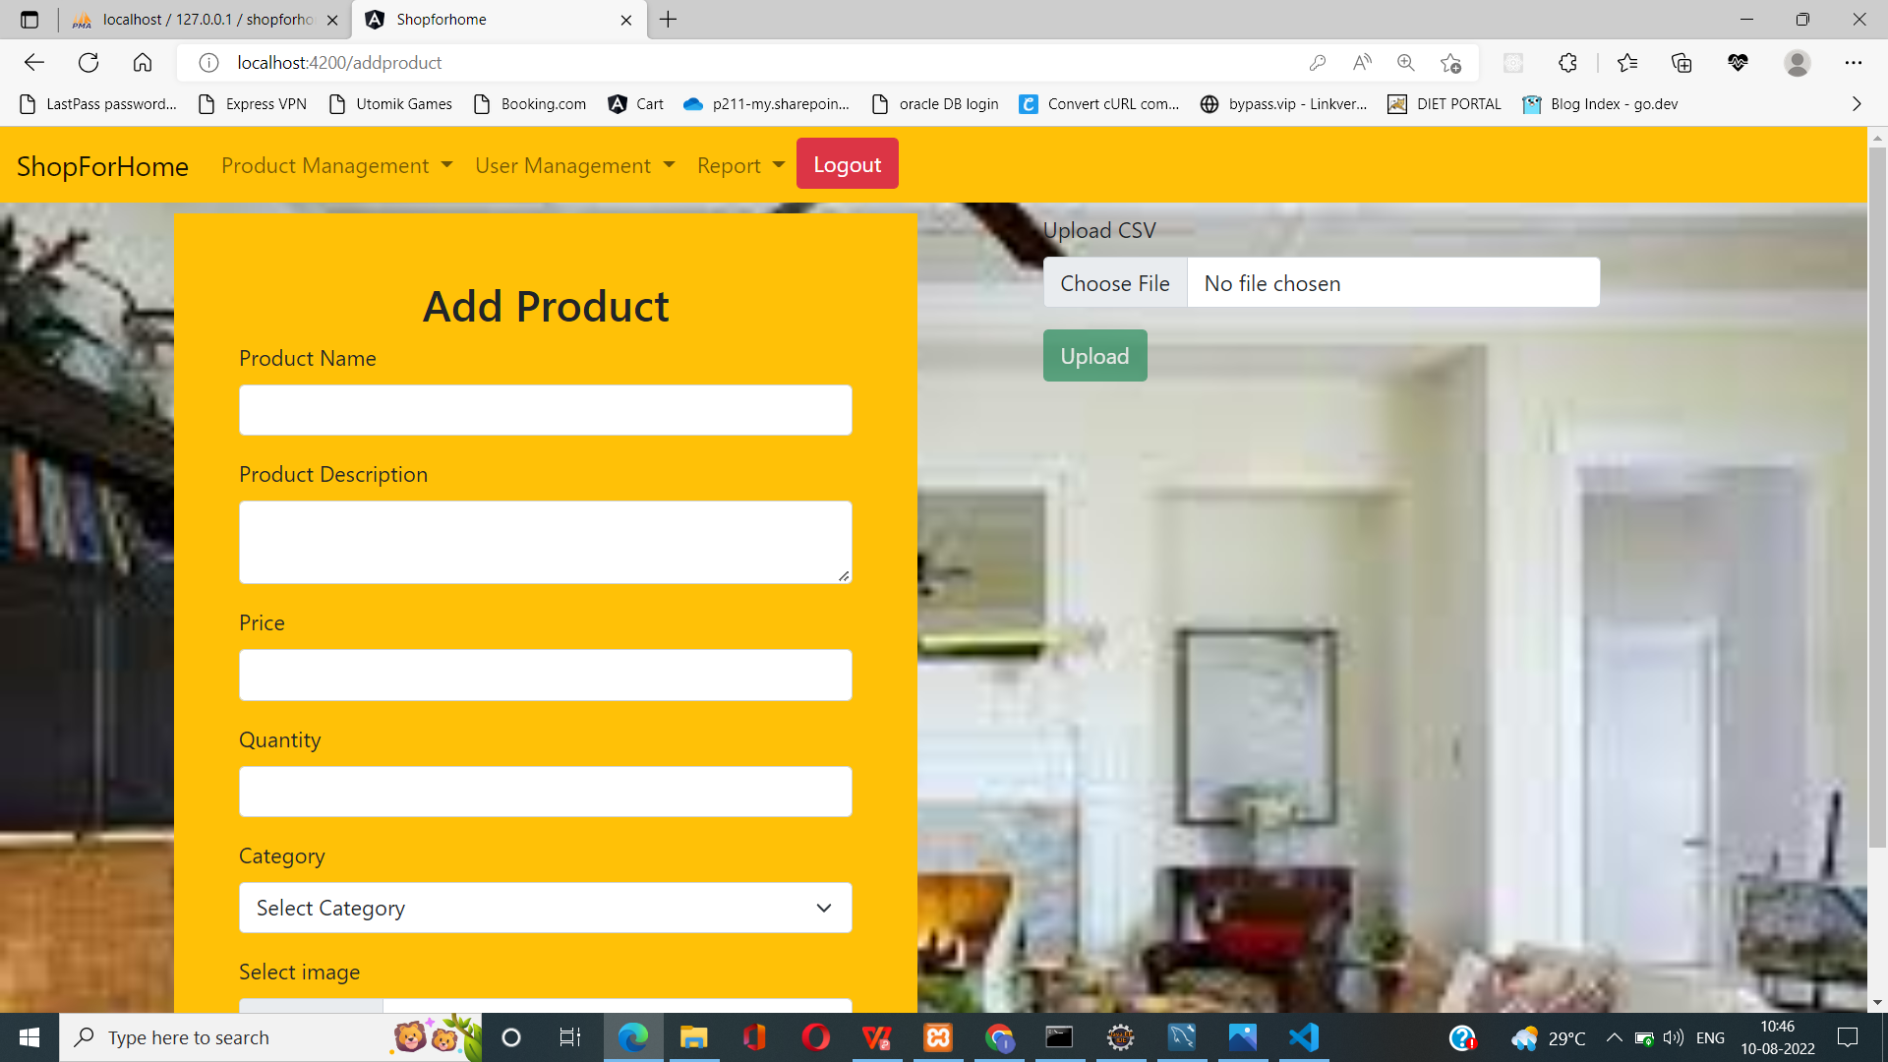
CRUD ON PRODUCT (Admin)

Slide 22
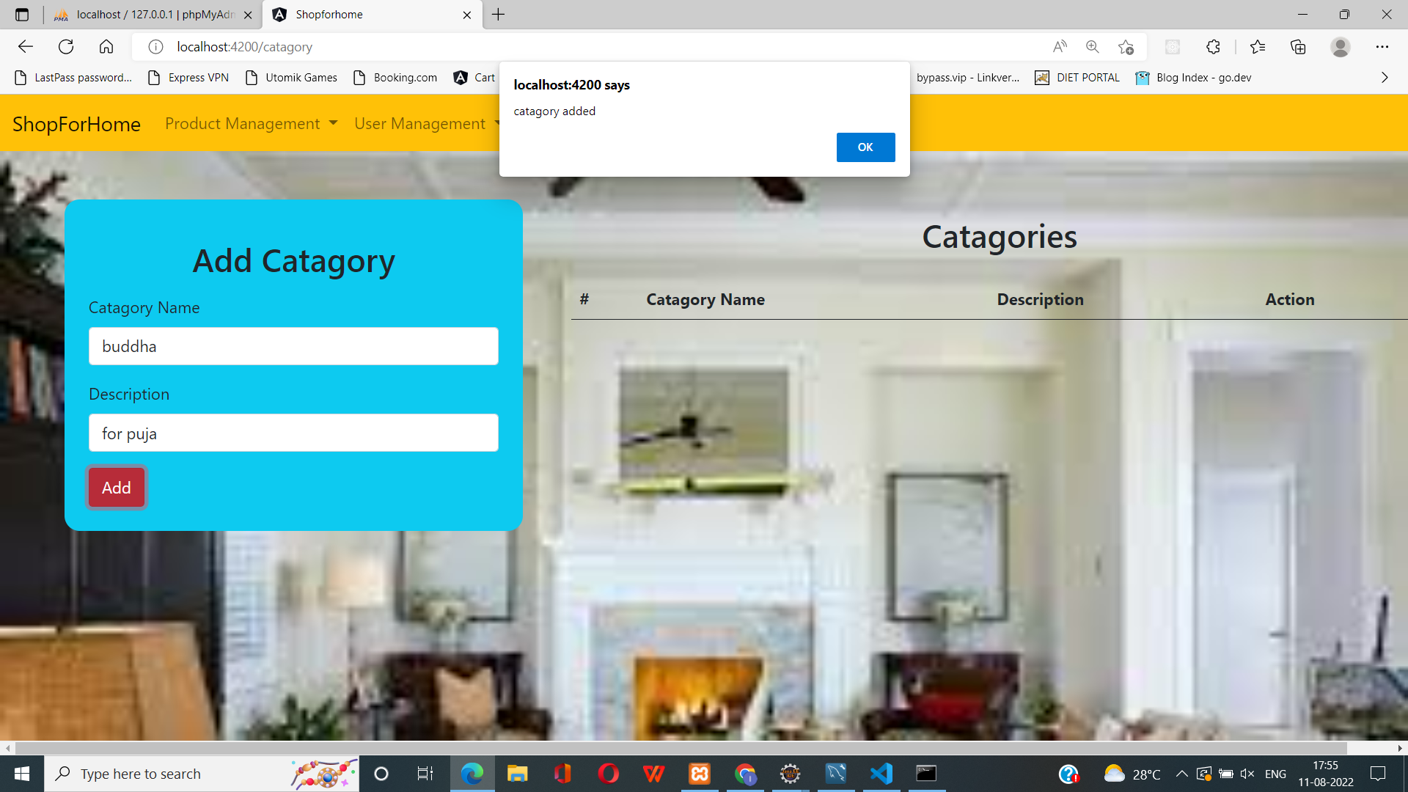
CRUD ON PRODUCT CATEGORY (Admin)

Slide 23
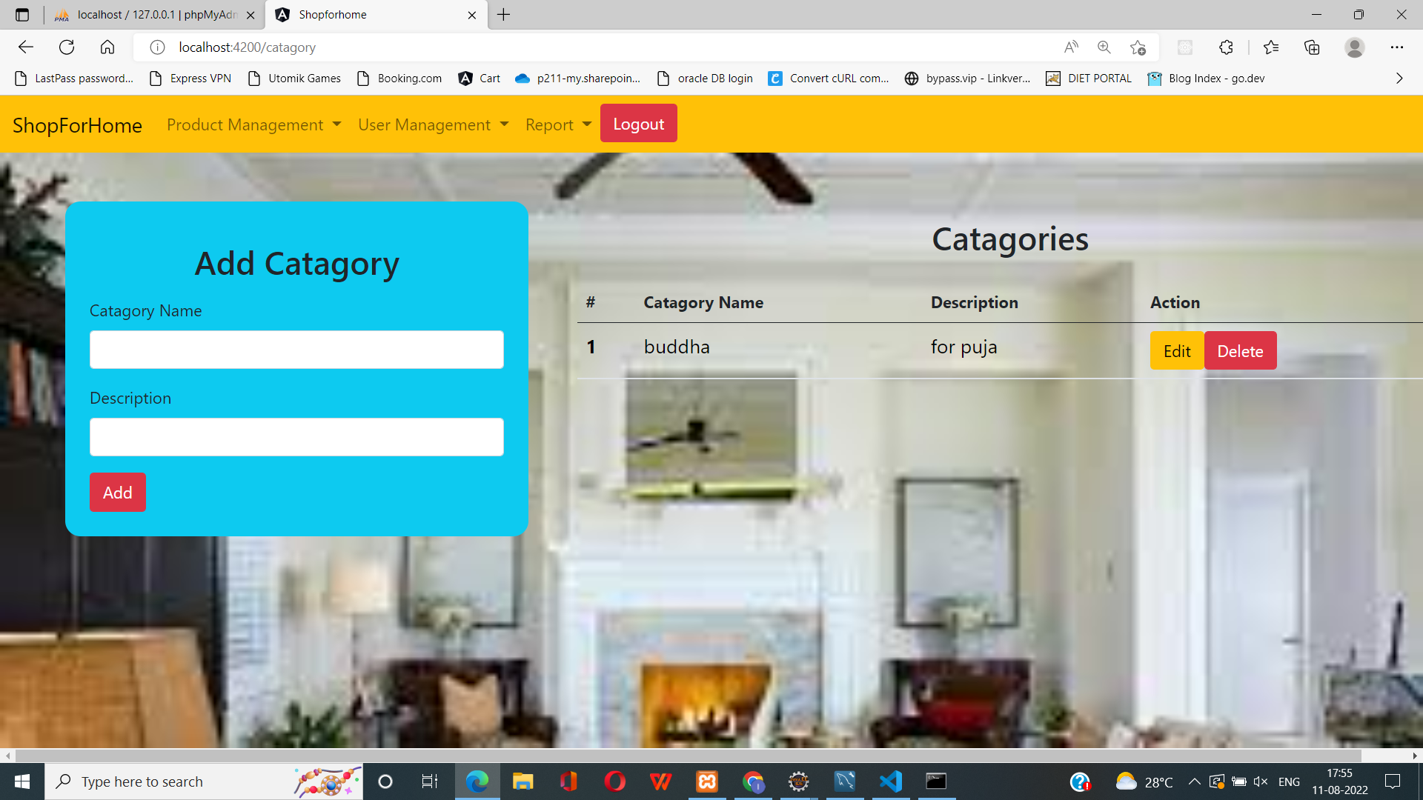
CRUD ON PRODUCT CATEGORY (Admin)

Slide 24
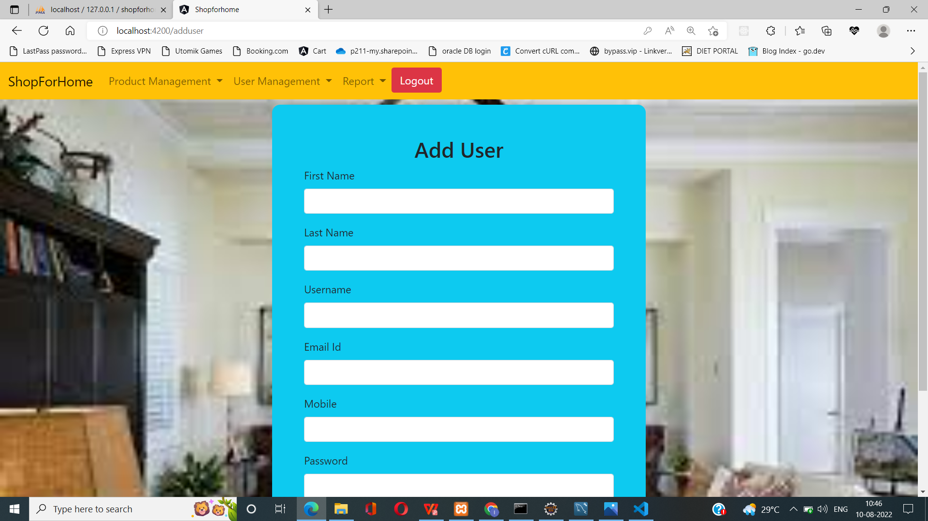
CRUD ON USER (Admin)

Slide 25
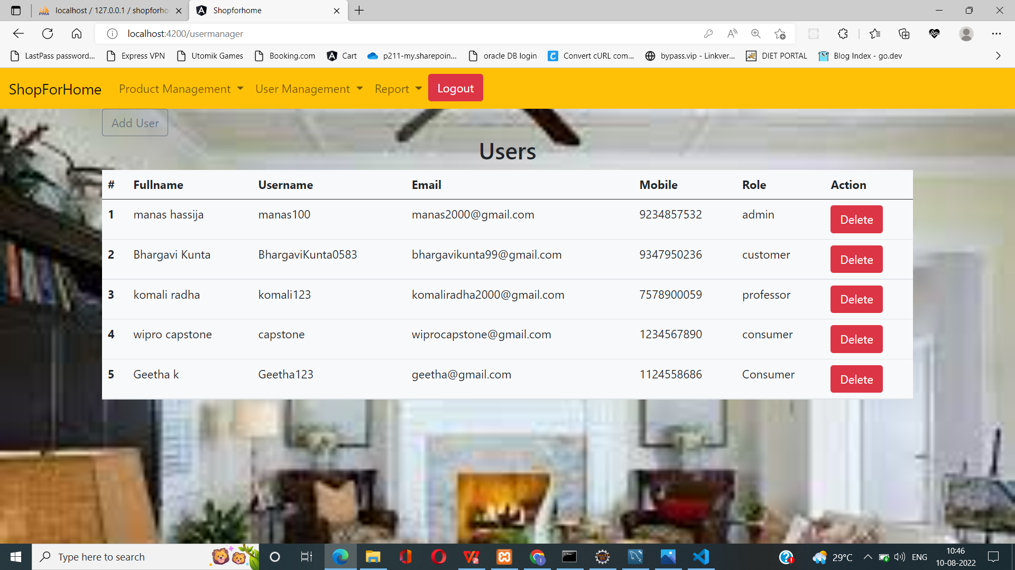
CRUD ON USER (Admin)

Slide 26
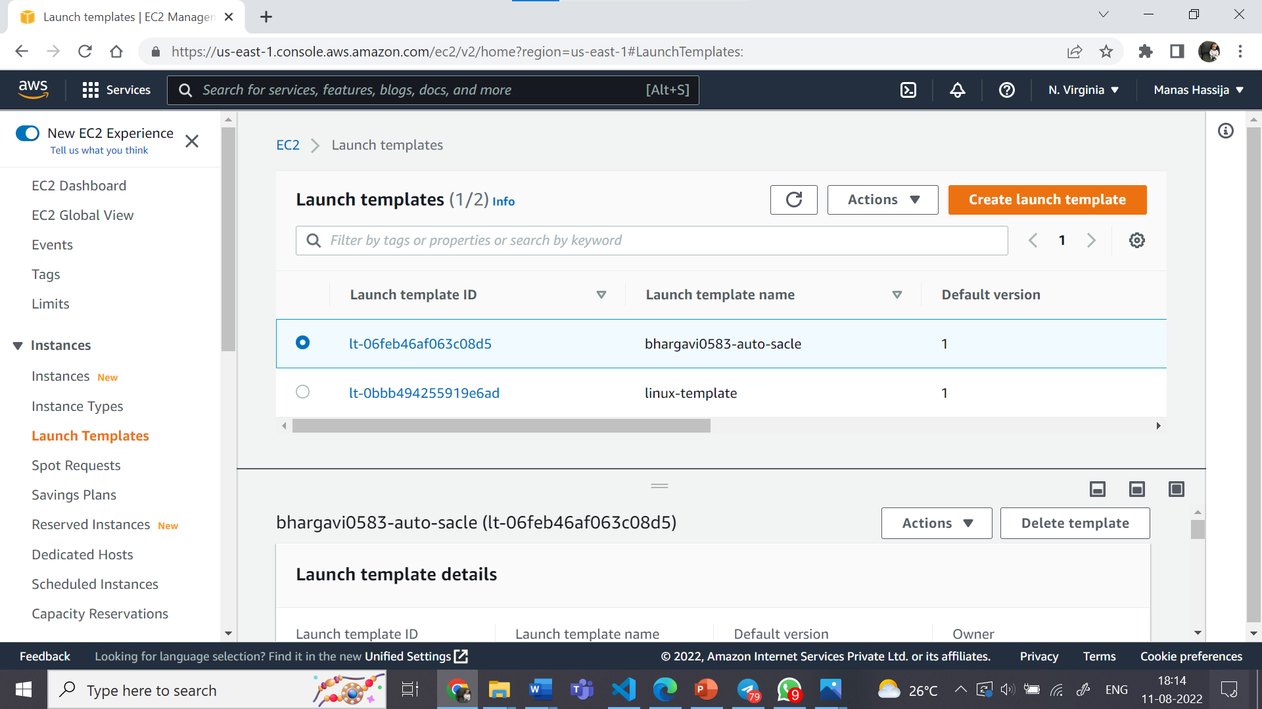
LAUNCH TEMPLATES

Slide 27
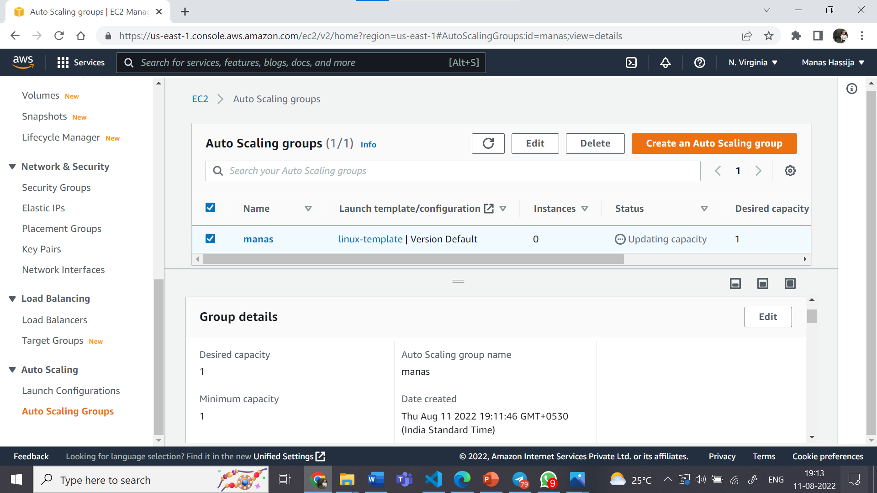
AUTO SCALING GROUP

Slide 28
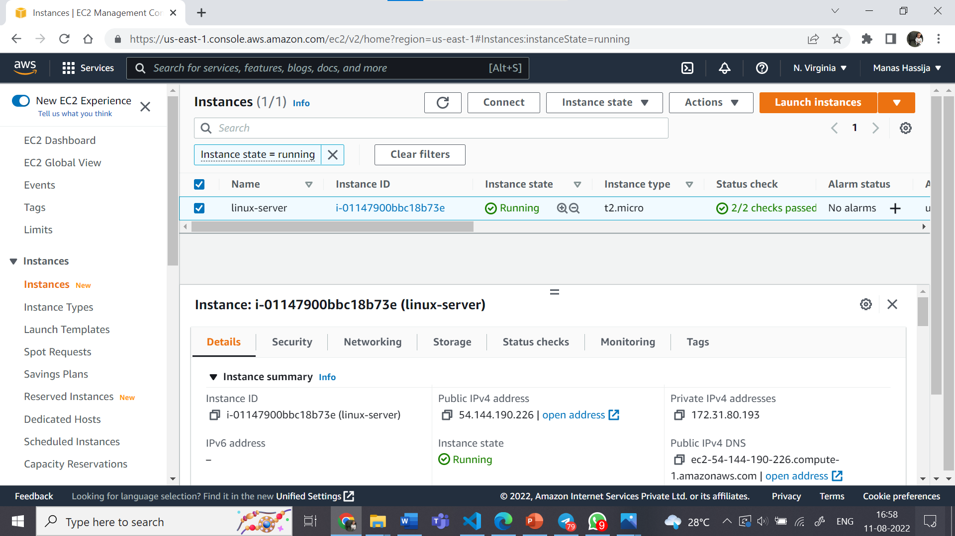
EC2 INSTANCES

Slide 29
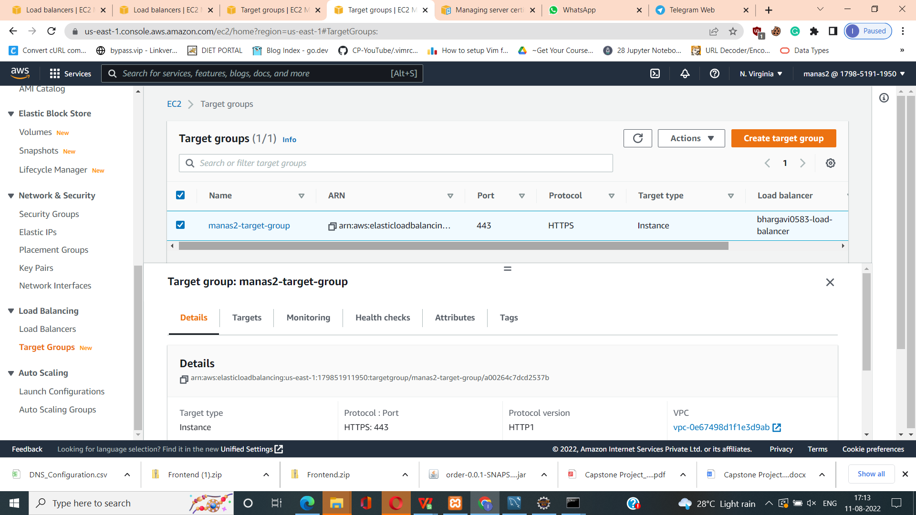
TARGET GROUP

Slide 30
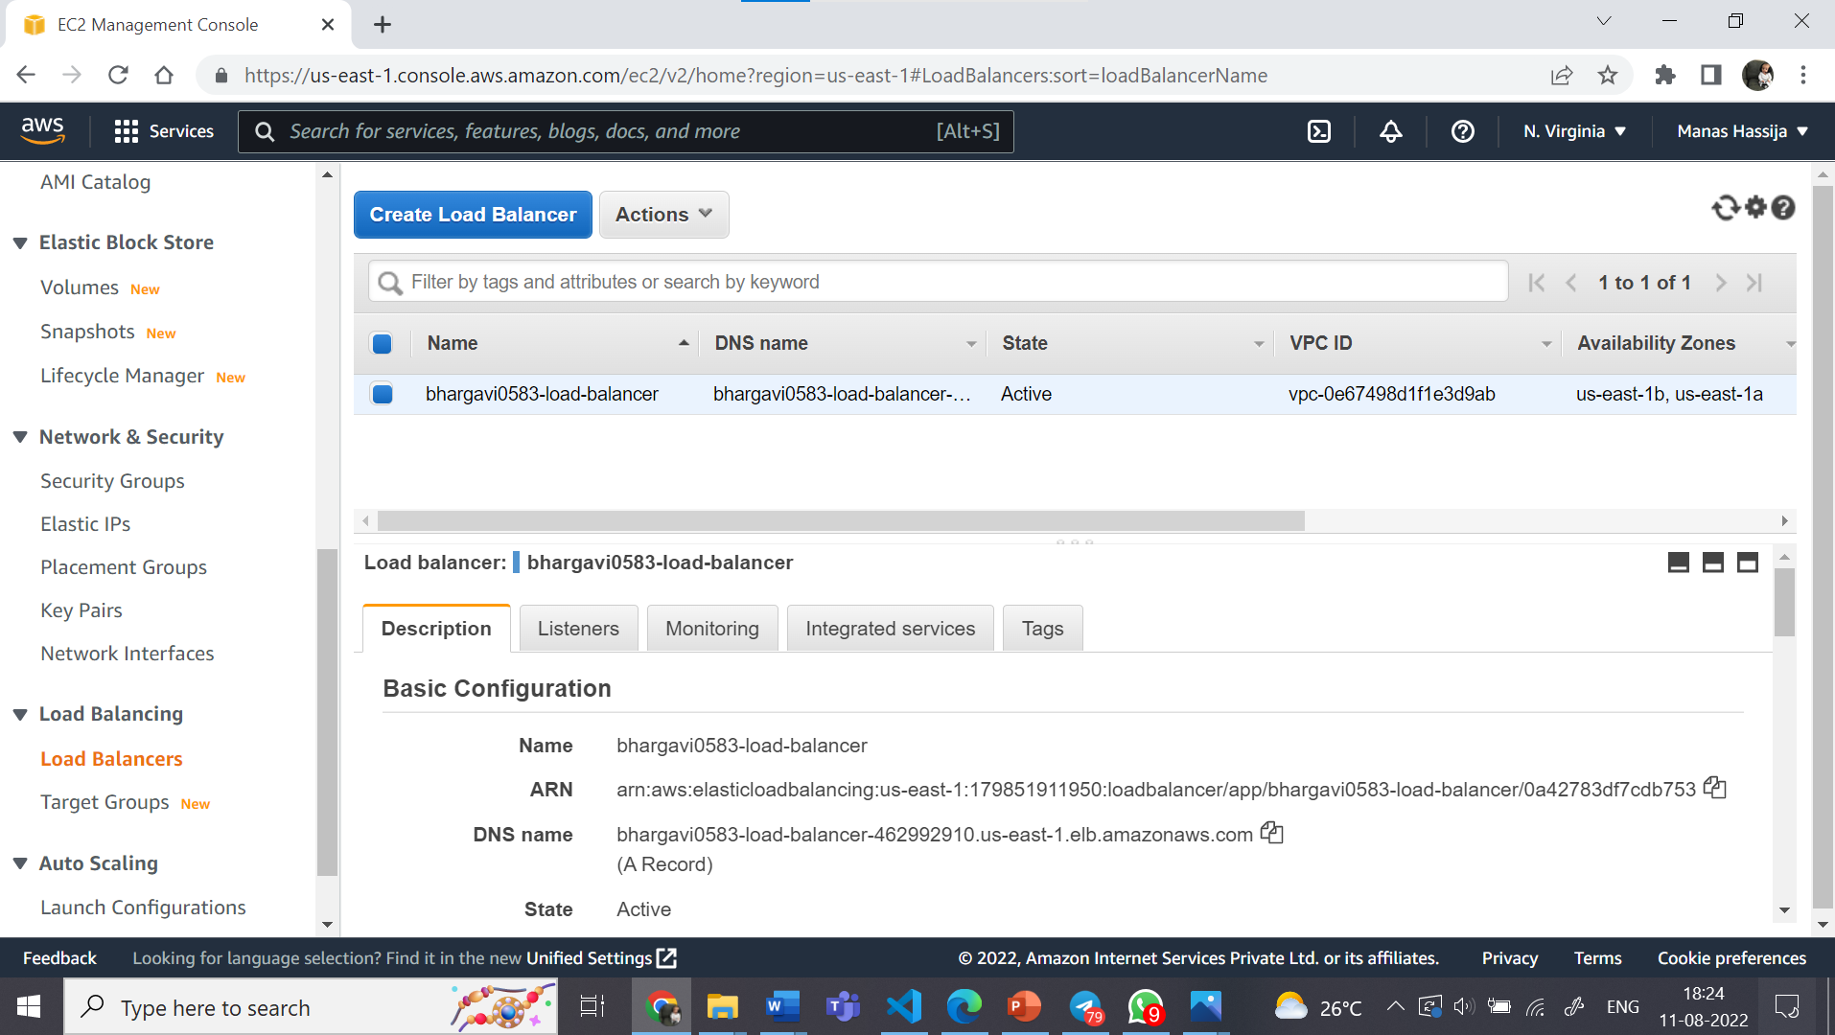
LOAD BALANCER

Slide 31
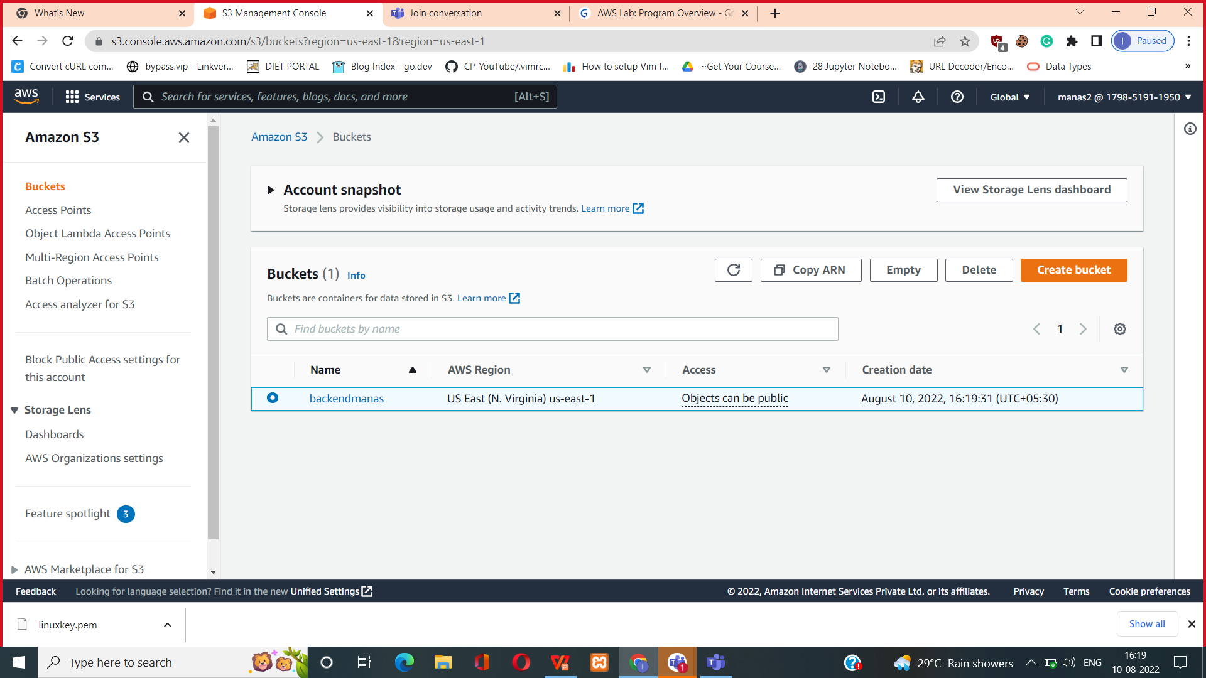
S3 BUCKET

Slide 32
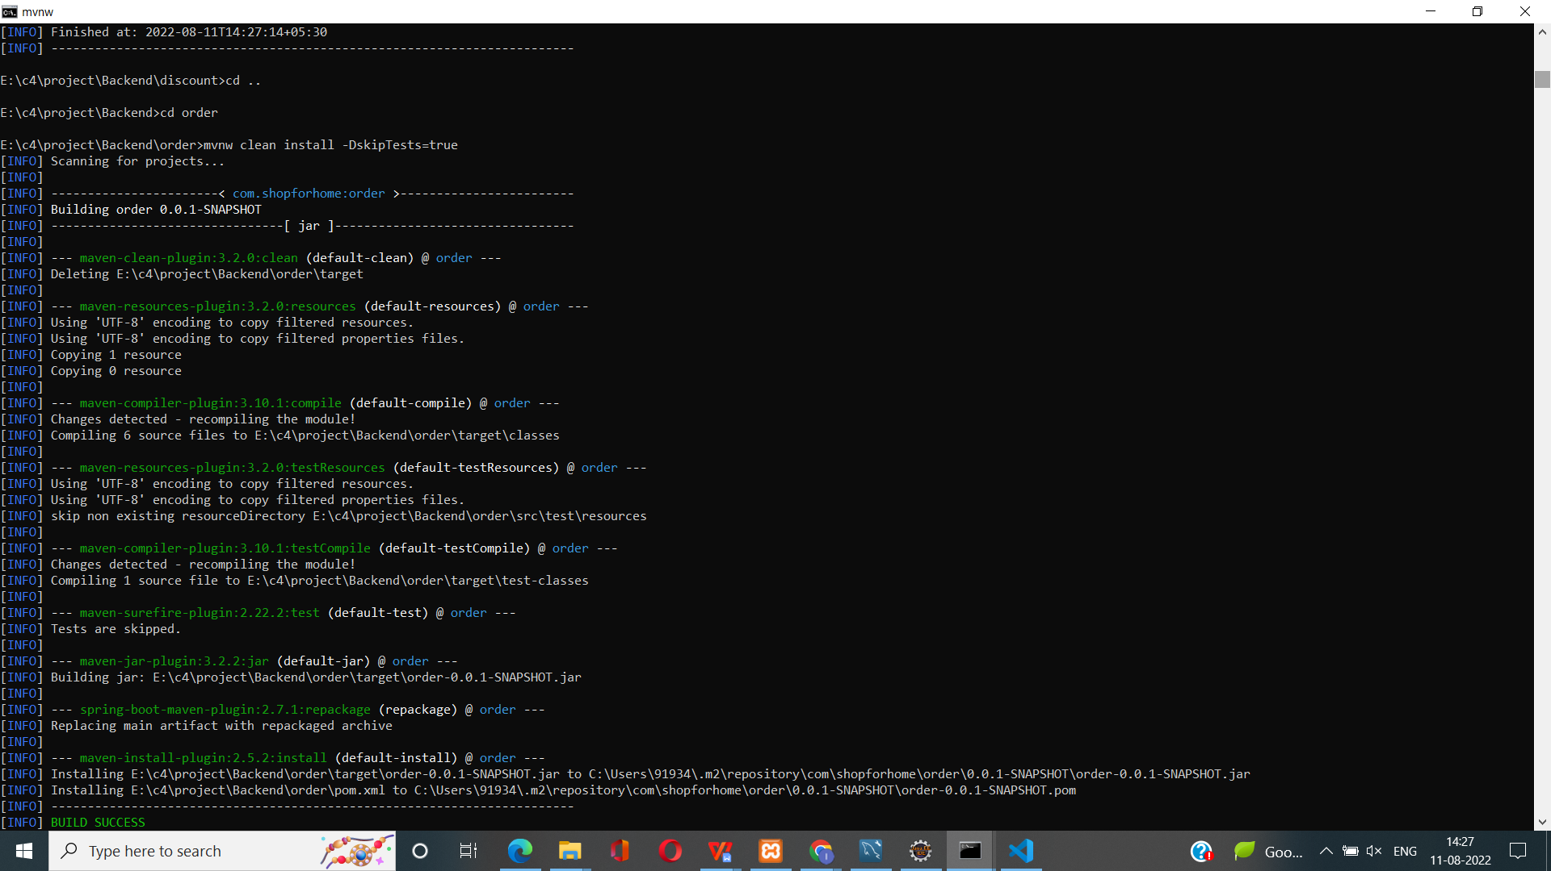
BUILDING JAR FILE

Slide 33
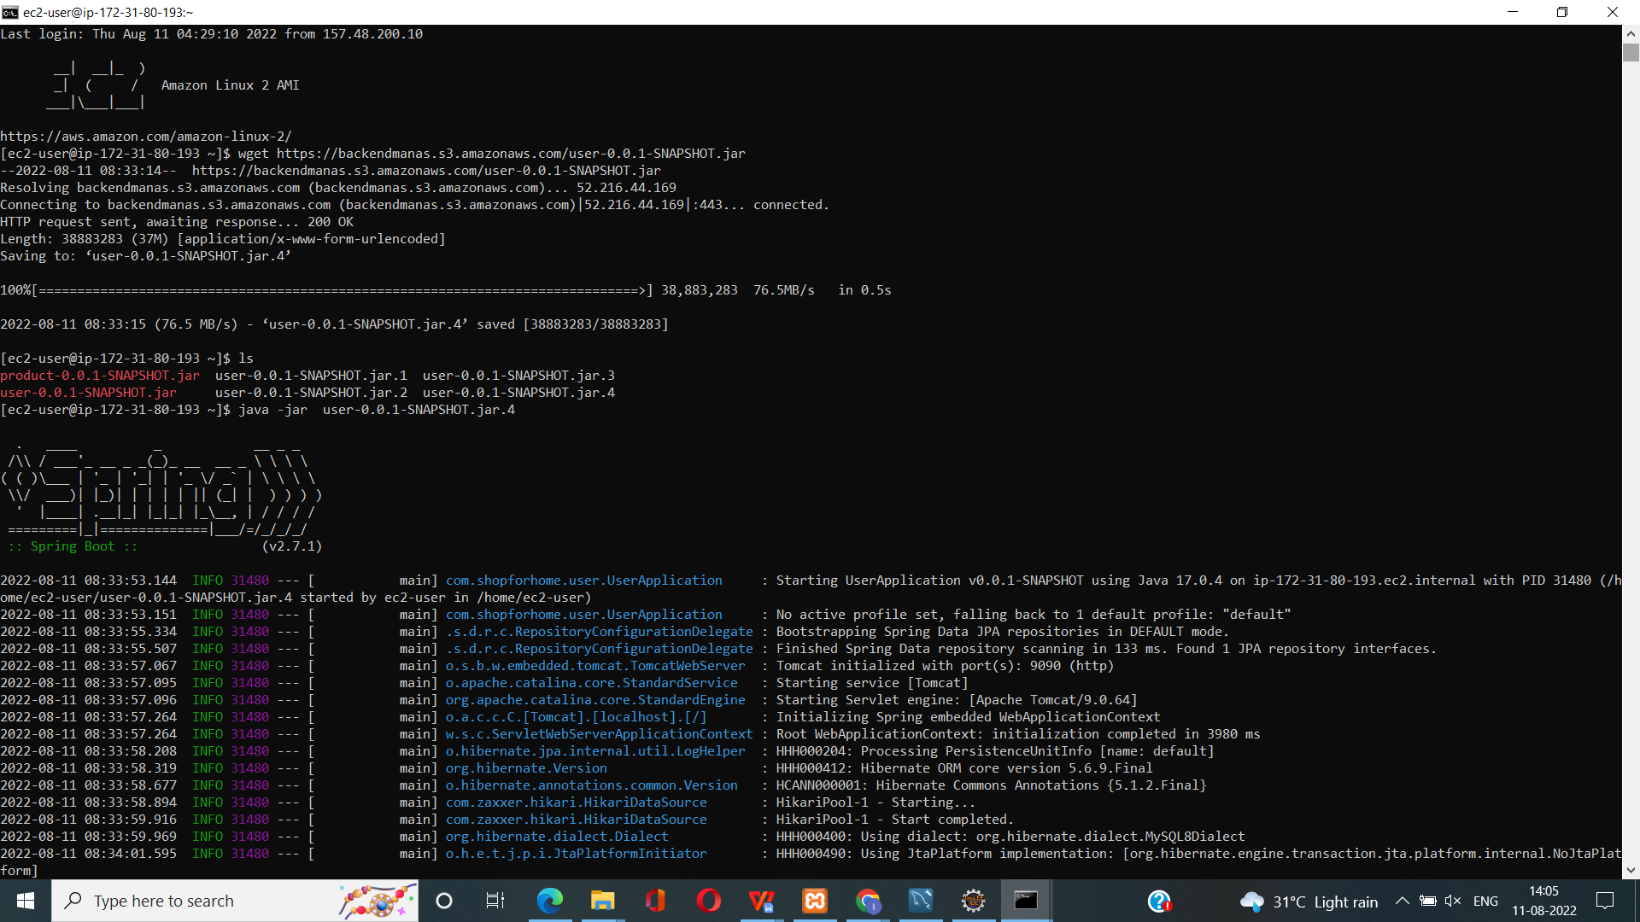
Starting the Application shop-for-home-.JAR

Slide 34
GIT HUB LINK
https://github.com/BhargaviKunta/BhargaviKunta.git

